Slide 1
Introducing
CSS Grid
IT STEP – 8
O.DEN

Slide 2
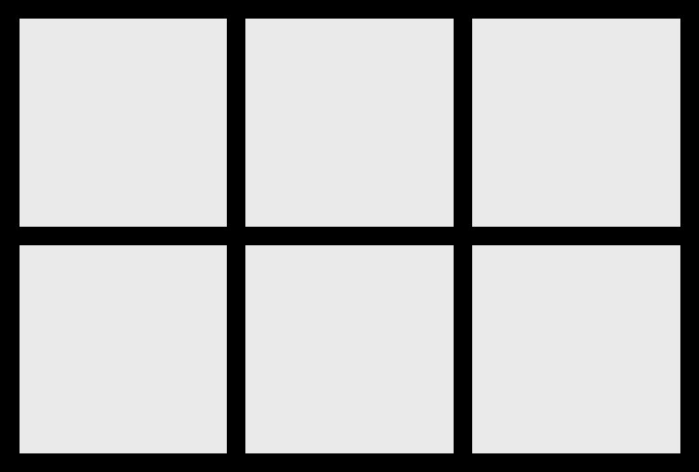
What Is
CSS Grid
CSS Grid is a 2 dimensional layout system that can handle both columns and rows.

Slide 3
Grid
Container
The grid container is the parent of all grid items. It is declared with the display: grid; rule.

Slide 4
Grid
Item
The items that are direct children of the grid container. These are the elements that will be placed on the grid.

Slide 5
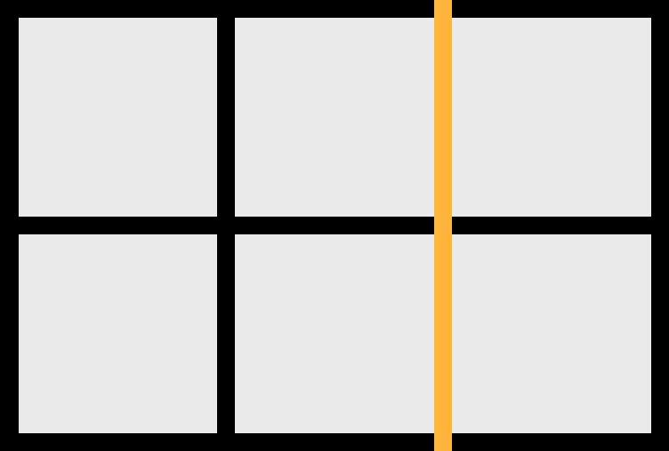
Grid
Lines
The lines that divide the columns and rows of the grid. These are numbered starting with 1.

Slide 6

Grid
Track
The space between 2 adjacent grid lines. Essentially your columns and rows.

Slide 7

Grid
Cell
The space between 2 adjacent grid column lines and 2 adjacent grid row lines.

Slide 8

Grid
Area
The space between any 4 grid lines. It can cover any number of rows and columns.

Slide 9
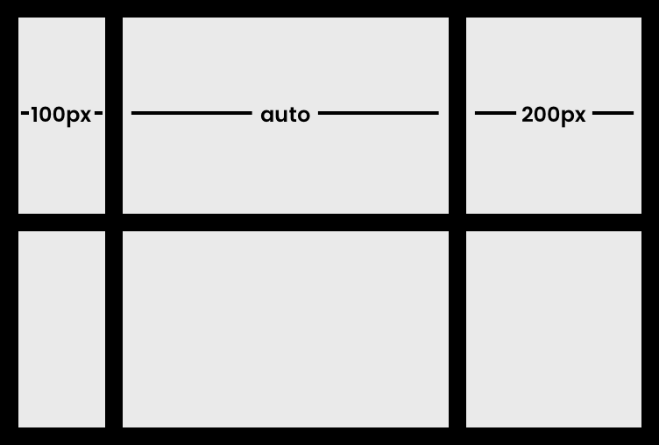
grid Template
Columns
Defines the width of the columns in the grid.
grid-template-columns: 100px auto 200px;

Slide 10
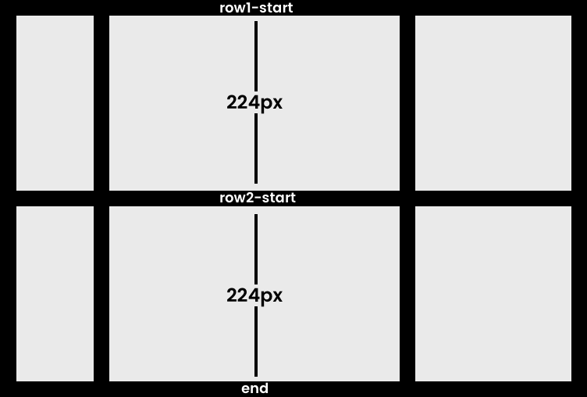
grid Template
rows
Defines the height of the grid rows.
grid-template-rows: [row1-start] 224px [row2-start] 224px [end];

Slide 11
grid column
gap
Define the size of the grid lines between columns.
grid-column-gap: 30px;

Slide 12
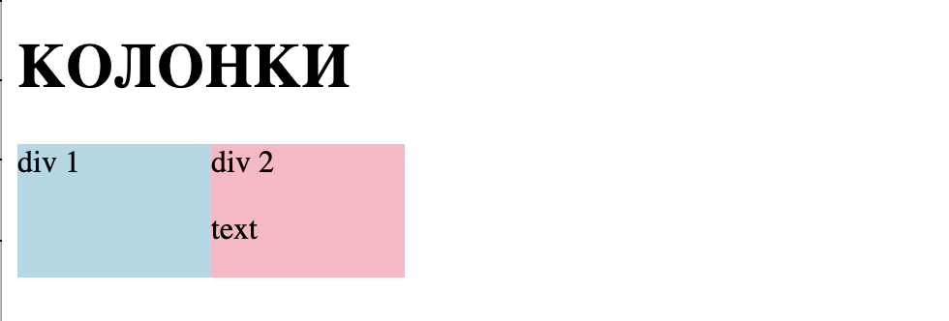
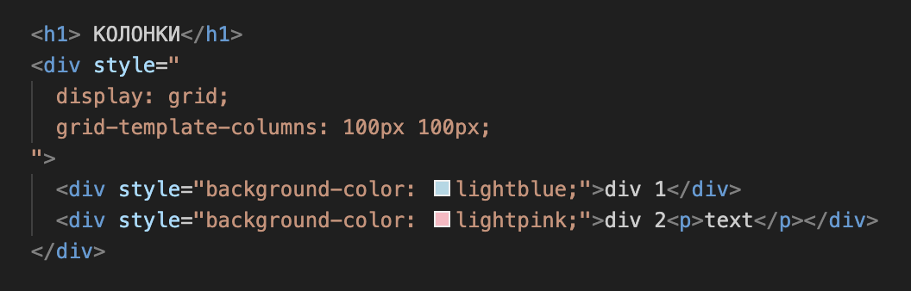
EXAMPLES
КОЛОНКИ
2 колонки по 100px

Slide 13
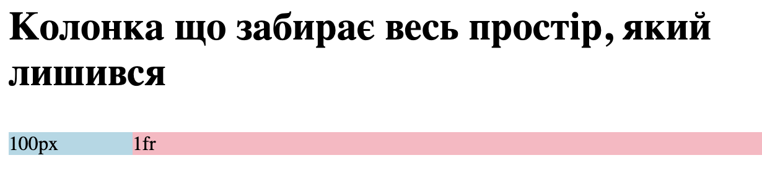
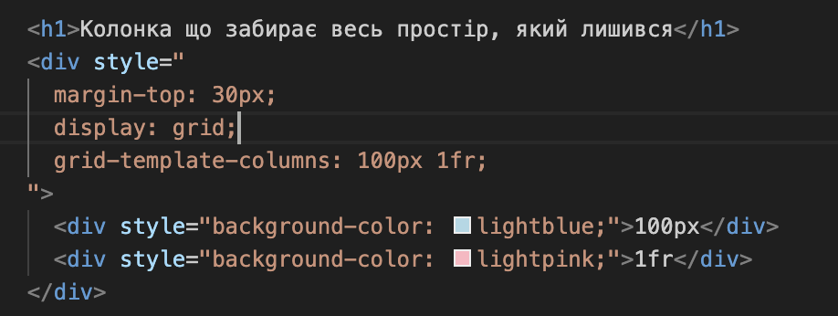
EXAMPLES
FRACTION
В CSS Grid одиниця виміру fr (fraction) використовується для позначення частини вільного простору, що залишився, у контейнері. Це означає, що ти можеш використовувати fr для створення колонок або рядків, які займають пропорційний простір залежно від доступної ширини або висоти.

Slide 14
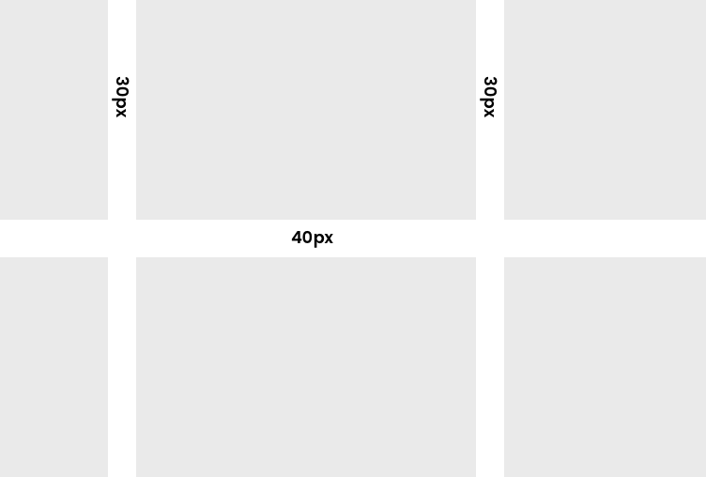
grid
gap
Shorthand for row and column gap.
grid-gap: <grid-row-gap> <grid-column-gap>;
grid-gap: 40px 30px;
Note: The gap is only between
columns and rows. Not outside.

Slide 15
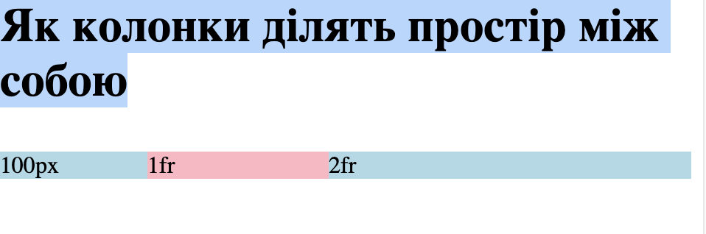
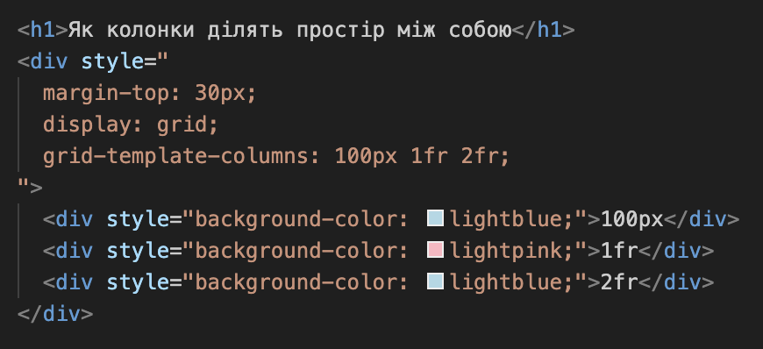
EXAMPLES
FRACTION
Як колонки ділять простір між собою

Slide 16
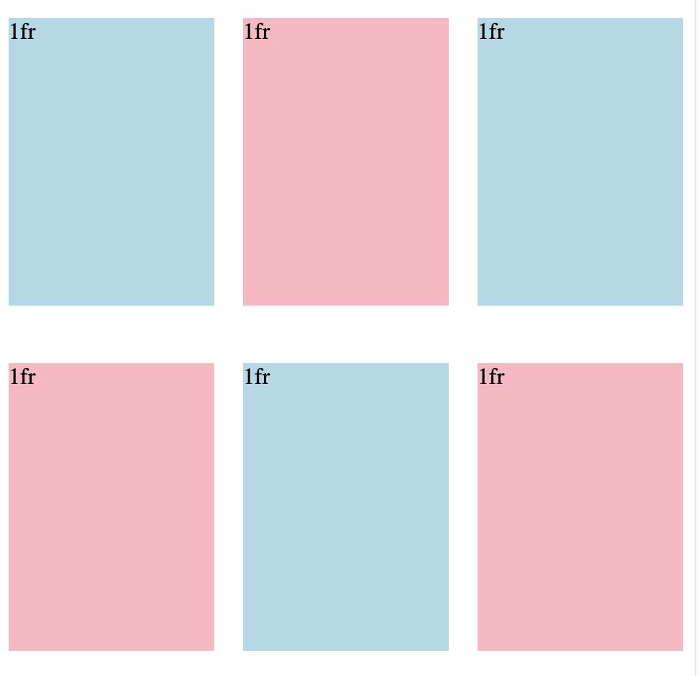
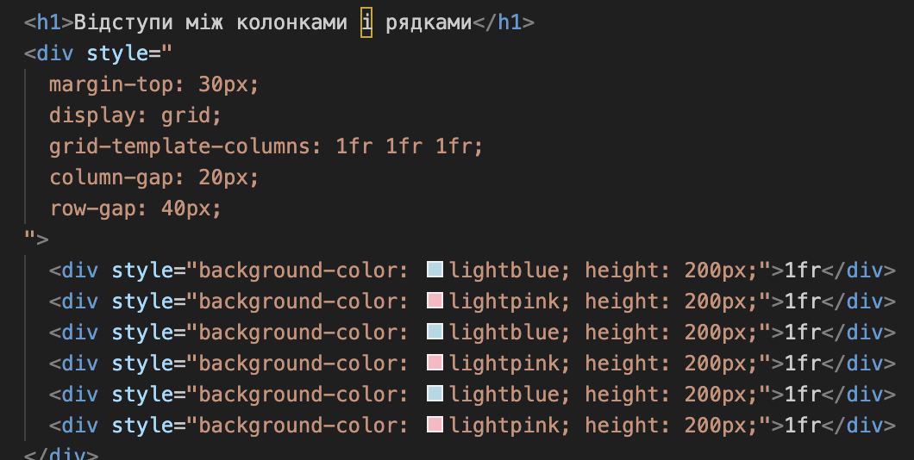
EXAMPLES
GAP
Відс

Slide 17
grid Row
gap
Defines the size of the grid lines between rows.
grid-row-gap: 40px;

Slide 18
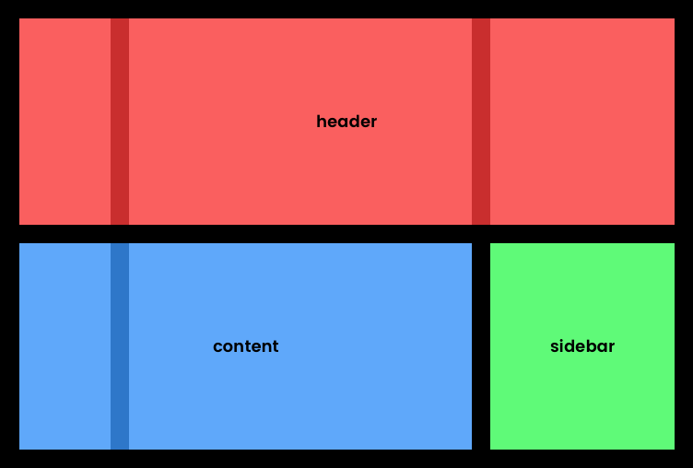
grid
template Area
Allows you to name sections of the grid.
grid-template-columns: 100px auto 200px;
grid-template-rows: [row1-start] 224px [row2-start] 224px [end];
grid-template-areas:
"header header header"
"content content sidebar";

Slide 19
fractional (fr)
units
Grid comes with the fr unit. Which uses up a fraction
of the remaining free space in the grid.
grid-template-columns: 1fr 50px 1fr 1fr;

Slide 20
repeat()
notation
Allows you to easily repeat settings.
grid-template-columns: repeat(12, 1fr);

Slide 21
grid column
start
Grid Column Start / Grid Column End | Grid Column
grid-column-start: 2;
grid-column-end: 4;
Shorthand
grid-column: 2 / 4;

Slide 22
grid row
start
Grid Row Start / Grid Row End | Grid Row
grid-row-start: 1;
grid-row-end: 2;
Shorthand
grid-row: 1 / 2;

Slide 23
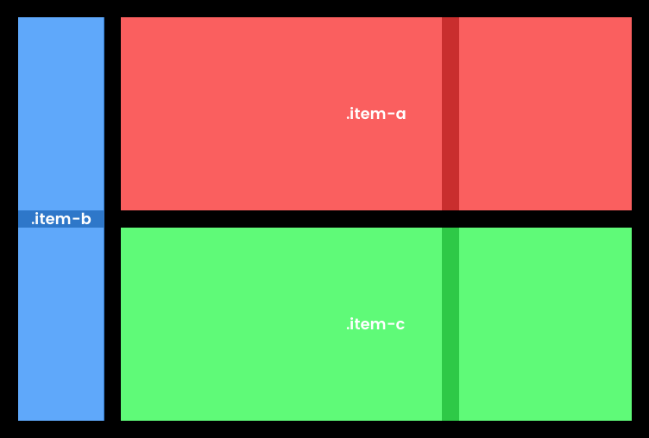
Placing
grid items

Slide 24
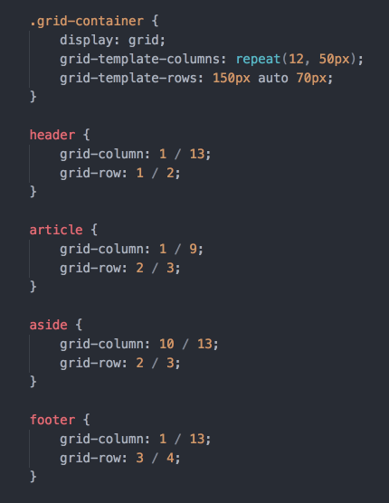
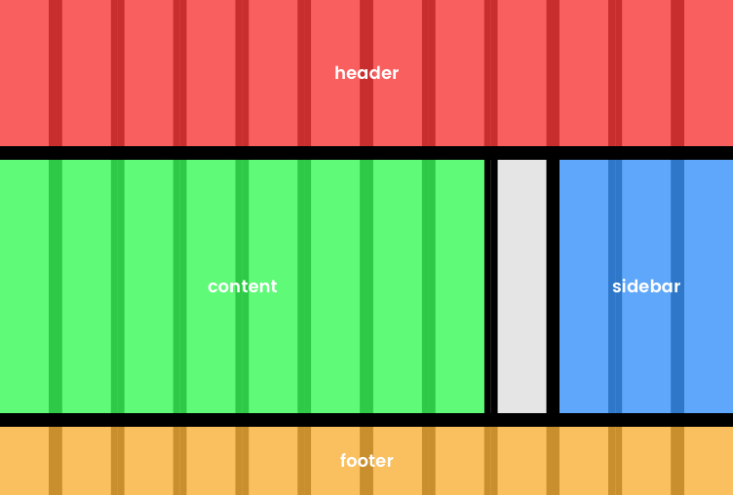
building
a layout

Slide 25
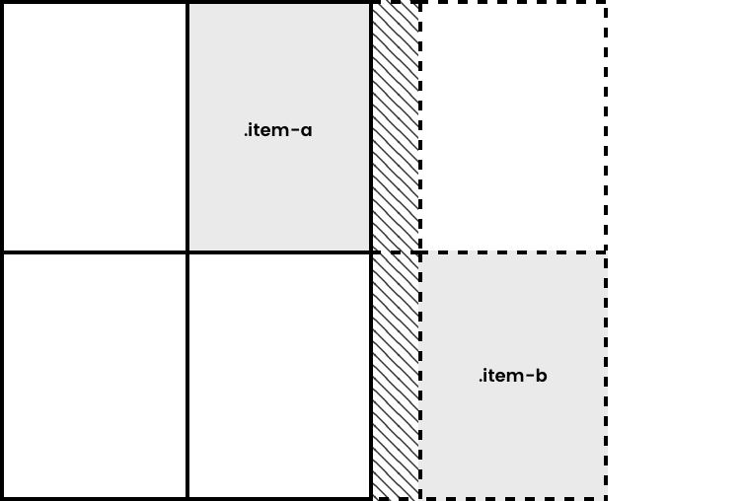
Grid auto
rows & columns
Set row or column sizes for those not explicitly set.

Slide 26
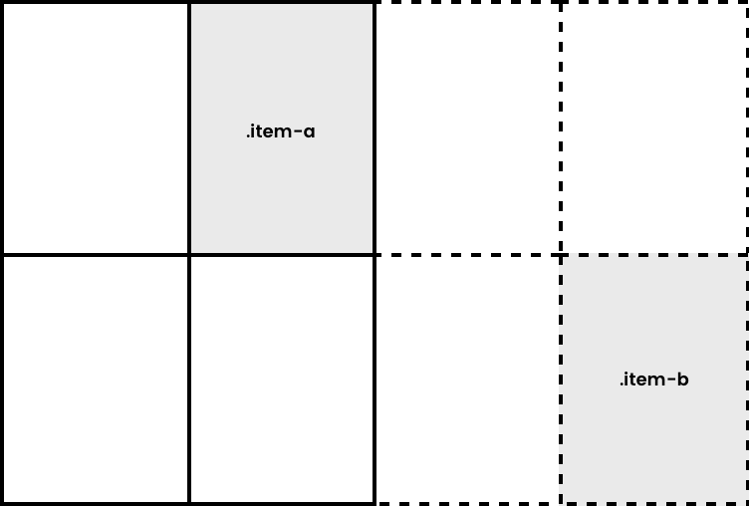
Grid auto
rows & columns
Set row or column sizes for those not explicitly set.

